Slide 1
Economic Activity Meeting
$
Here is where your presentation begins

Slide 2
Contents of this template
You can delete this slide when you’re done editing the presentation
Fonts | To view this template correctly in PowerPoint, download and install the fonts we used
Used and alternative resources | An assortment of graphic resources that are suitable for use in this presentation
Thanks slide | You must keep it so that proper credits for our design are given
Colors | All the colors used in this presentation
Icons and infographic resources | These can be used in the template, and their size and color can be edited
Editable presentation theme | You can edit the master slides easily. For more info, click here
For more info:
SLIDESGO | BLOG | FAQs
You can visit our sister projects:
FREEPIK | FLATICON | STORYSET | WEPIK | VIDEVO

Slide 3
Table of contents
01
04
02
05
03
06
Section
Section
Section
Section
Section
Section

Slide 4
One column
Do you know what helps you make your point clear? Lists like this one:
They’re simple
You can organize your ideas clearly
You’ll never forget to buy milk!
You can replace the image. Just right-click on it and select “Replace image”

Slide 5
01
Section header
$
$

Slide 6
Two ideas
Mercury
Venus
Mercury is the closest planet to the Sun and the smallest one in the Solar System—it’s only a bit larger than the Moon. This planet’s name has nothing to do with the liquid metal, since Mercury was named after the Roman messenger god
Venus has a beautiful name and is the second planet from the Sun. It’s terribly hot—even hotter than Mercury—and its atmosphere is extremely poisonous. It’s the second-brightest natural object in the night sky after the Moon

Slide 7
Three ideas
Jupiter
Venus
Saturn
Jupiter is a gas giant and the biggest planet in the Solar System. It's the fourth-brightest object in the night sky and was named after the Roman god of the skies
Venus has a beautiful name and is the second planet from the Sun. It’s terribly hot and its atmosphere is poisonous. It’s the second-brightest natural object in the night sky
Saturn is a gas giant and has several rings. This planet is composed mostly of hydrogen and helium. It’s the sixth planet from the Sun and was named after a Roman god

Slide 8
Four ideas
Mars
Venus
Despite being red, Mars is actually a cold place. It's full of iron oxide dust, which gives the planet its reddish cast, and it’s made of basalt
Venus has a beautiful name and is the second planet from the Sun. It’s terribly hot and its atmosphere is extremely poisonous
Jupiter
Saturn
Jupiter is a gas giant and the biggest planet in the Solar System. It's the fourth-brightest object in the night sky. It was named after a Roman god
Saturn is a gas giant and has several rings. It's composed mostly of hydrogen and helium. It’s the sixth planet from the Sun

Slide 9
Six ideas
Mars
Venus
Neptune
Despite being red, Mars is actually a cold place. It's full of iron oxide dust, which gives the planet its reddish cast
Venus has a beautiful name and is the second planet from the Sun. It’s terribly hot, even hotter than Mercury
Neptune is the farthest planet from the Sun. It's also the fourth-largest planet by diameter in the Solar System
Earth
Saturn
Jupiter
Earth is the third planet from the Sun and the only one that harbors life in the Solar System. We all live on this planet
Saturn is a gas giant and has several rings. It's composed of hydrogen and helium. It’s the sixth planet from the Sun
Jupiter is a gas giant and the biggest planet in the Solar System. It's the fourth-brightest object in the night sky

Slide 10
—Someone famous
“This is a quote, words full of wisdom that someone important said and can make the reader get inspired”
$

Slide 11
333,000
9h 55m 23s
36,000 km
The Sun’s mass compared to Earth’s
$
$
$
Jupiter’s rotation period
Distance between Earth and the Moon

Slide 12
98,300,000
$
$
Big numbers catch your audience’s attention

Slide 13
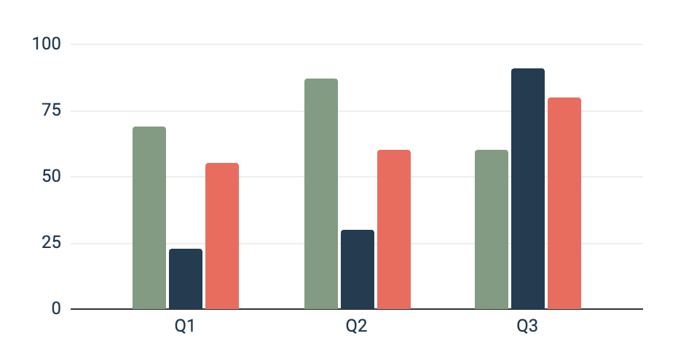
Column graph
Team 1
Team 2
Team 3
Mars is very cold
Mercury is small
Venus is very hot
Follow the link in the graph to modify its data and then paste the new one here. For more info, click here

Slide 14
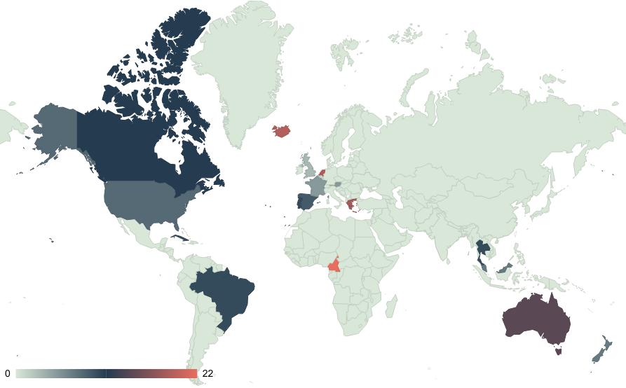
Map
Mars
Mercury
Venus
Mars is very cold
Mercury is small
Venus is very hot
Follow the link in the map to modify its data and then paste the new one here. For more info, click here

Slide 15
Table
 | Description | Year | Team A | Team B
Mercury | Mercury is a small planet | 20XX | 47% | 53%
Mars | Mars is a cold planet | 20XX | 20% | 80%
Saturn | Saturn is a gas giant | 20XX | 51% | 49%
Venus | Venus is a hot planet | 20XX | 32% | 68%
Jupiter | Jupiter is a gas giant | 20XX | 70% | 30%
Earth | We all live on Earth | 20XX | 55% | 45%

Slide 16
Timeline
Step 1
Step 2
Step 3
Step 4
Mercury is the smallest planet of them all
Venus is the second planet from the Sun
Earth is the beautiful planet on which humans live
Despite being red, Mars is actually a cold place

Slide 17
Organizational chart
The Sun
CEO
Jupiter
Department Head
Neptune
Department Head
Saturn
Manager
Earth
Manager
Venus
Manager
Mars
Manager
Moon
Employee
Titan
Employee
Triton
Employee
Callisto
Employee

Slide 18
Roadmap infographic
Initiative | Objective | Month 1 |  |  | Month 2 |  |  | Month 3
Venus is very hot | Venus has a beautiful name and is the second planet from the Sun
Earth has life | Earth is the beautiful planet on which humans live
Mars is very cold | Despite being red, Mars is actually a cold place
Jupiter is a gas | Jupiter is the biggest planet in the Solar System
Saturn has rings | Saturn is a gas giant and has several rings
Mercury is small | Mercury is the closest planet to the Sun and the smallest one

Slide 19
Thanks!
Do you have any questions?
youremail@freepik.com
+34 654 321 432
yourwebsite.com
$
$
Please keep this slide for attribution

